Slide 1

Data Analyst
Basic Functions of a Data Analyst
Roadmap – Skills Required
Data Analyst Career
26th March 25

Slide 2

Basic functions of a Data Analyst
Eventually maximizes the output for generating more business values.
Understanding lifecycle of a Data Analyst
Data Gathering & Cleaning
Organize the data, ensuring its accuracy and completeness
Data Analysis & Pattern Identification
Using statistical methods, programming languages, and data visualization tools, analysts explore and analyze the data.
Insight Communication & Reporting
Data analysts go beyond interpreting data; they use it to solve problems and improve processes in various contexts.
Search for patterns, trends, and anomalies, revealing hidden connections and insights within the information.
Examples - Business Intelligence, Finance, Healthcare, Social Media, Marketing, Operations Analyst

Slide 3
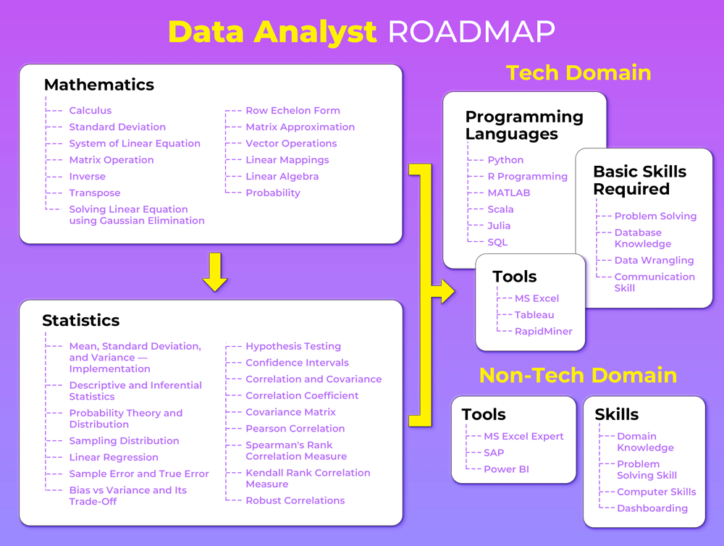

Roadmap – Skills Required

Slide 4
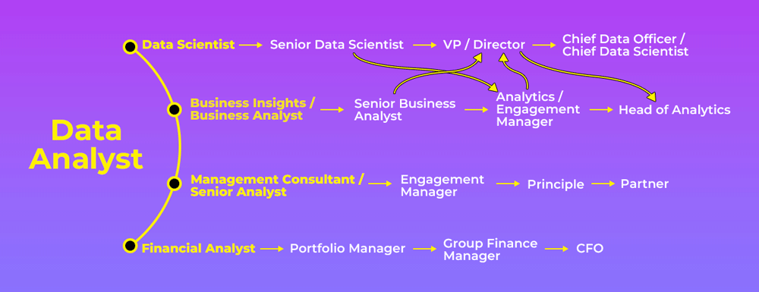

Data Analyst Career

